Slide 1
Trajectory Optimization for Thermally-Actuated Soft Planar Robot Limbs
Anthony Wertz (me), Andrew P. Sabelhaus, Carmel Majidi
April 22, 2022
A. Wertz, A. P. Sabelhaus, and C. Majidi, “Trajectory optimization for thermally-actuated soft planar robot limbs,” in IEEE 5th International Conference on Soft Robotics (RoboSoft). 2022.
Notes:
Hello everyone, thank you for being here.
My name is Anthony Wertz and I’m going to preset this work we had accepted at this year’s IEEE Soft Robotics Conference on Trajectory Optimization for Thermally-Actuated Soft Planar Robot Limbs.

Slide 2

Project at a glance
Sensorizing a compliant, thermally actuated robot limb
Develop simplified system model
Calibrate model parameters
Trajectory optimization for open-loop control
Validate in hardware
Future directions
A. Wertz, A. P. Sabelhaus, and C. Majidi, “Trajectory optimization for thermally-actuated soft planar robot limbs,” in IEEE 5th International Conference on Soft Robotics (RoboSoft). 2022.
Notes:
I will start by giving you the ten thousand foot view, and a bit of the agenda, which I’ll go over while this video plays for a bit on the right.
We’re going to discuss a thermally-actuated compliant robot limb that we built in the lab.
We will then talk about the model simplifications made to arrive at system dynamics and kinematics.
We’ll discuss the approaches we used to strategically collect data for model parameter identification.
I will discuss how we used trajectory optimization to design a feasible trajectory from a desired reference and open-loop controls to realize it.
We’ll see how well this work transferred to hardware.
Finally, we’ll discuss some future directions for this work.

Slide 3
Overview
Background, Hardware, Experiment
Notes:
First, an overview, with some background and a look at the hardware and experimental designs.

Slide 4
Background
Soft systems are hard to model
Kinematics hard - “Infinite” DoF
Dynamics hard - Continuum deformation and rate-dependent mechanics
Thermal actuation of shape memory alloy (SMA) is hard to model
Difficult/impossible to measure metallurgical state
Difficult to deal with hysteresis
Open-loop control not well-explored
Since modeling is difficult, mostly just use some form of sensing and control
Not as good for untethered applications or planning
Notes:
So why is this interesting?

Slide 5
Background
Soft systems are hard to model
Kinematics hard - “Infinite” DoF
Dynamics hard - Continuum deformation and rate-dependent mechanics
Thermal actuation of shape memory alloy (SMA) is hard to model
Difficult/impossible to measure metallurgical state
Difficult to deal with hysteresis
Open-loop control not well-explored
Since modeling is difficult, mostly just use some form of sensing and control
Not as good for untethered applications or planning
Notes:
Well, soft systems are particularly interesting in robotics because they’re typically quite difficult to model accurately under various operational conditions.
Starting with kinematics, you might have heard them described as having “infinite” degrees of freedom, because, while significant motion in rigid systems largely happens in more predictable ways on well defined coordinates, such as revolving about revolute joint, soft systems can deform and move into innumerable configurations, depending on the particular loading conditions and material state.
Soft systems are also much more likely to experience a mechanical instability, like buckling, as compared to their rigid counterparts.
The dynamics are difficult to model as well, because in addition to the significant influence of the material parameters, they will also exhibit more complicated behaviors when they experience some new loading, like actuation or contact, and have significant rate dependency as well.

Slide 6
Background
Soft systems are hard to model
Kinematics hard - “Infinite” DoF
Dynamics hard - Continuum deformation and rate-dependent mechanics
Thermal actuation of shape memory alloy (SMA) is hard to model
Difficult/impossible to measure metallurgical state
Difficult to deal with hysteresis
Open-loop control not well-explored
Since modeling is difficult, mostly just use some form of sensing and control
Not as good for untethered applications or planning
Notes:
Thermal actuation of shape memory alloys (which I’ll talk about later) is also challenging to model.
Precisely tracking the dynamics of the system requires knowledge of metallurgical state that is difficult or impossible to measure in real time.
We also encounter hysteretic behavior in the material as well, which further complicates things.

Slide 7
Background
Soft systems are hard to model
Kinematics hard - “Infinite” DoF
Dynamics hard - Continuum deformation and rate-dependent mechanics
Thermal actuation of shape memory alloy (SMA) is hard to model
Difficult/impossible to measure metallurgical state
Difficult to deal with hysteresis
Open-loop control not well-explored
Since modeling is difficult, mostly just use some form of sensing and control
Not as good for untethered applications or planning
Notes:
For these reasons, open-loop control in such a system, incorporating thermal actuation with a compliant mechanism, is not particularly well explored in the literature.
Because the modeling is challenging, typical applications of such systems rely on sensorization and feedback control to achieve a desired motion trajectory.
This may be less desirable for small or untethered applications where you may want to economize power or space utilization on the device, making such integrated sensorization difficult or impossible to realize, as well as planning applications where you want to understand the capabilities of the system or design a system to perform complicated tasks or meet particular requirements like adherence to safety constraints or minimizing energy expenditure.

Slide 8
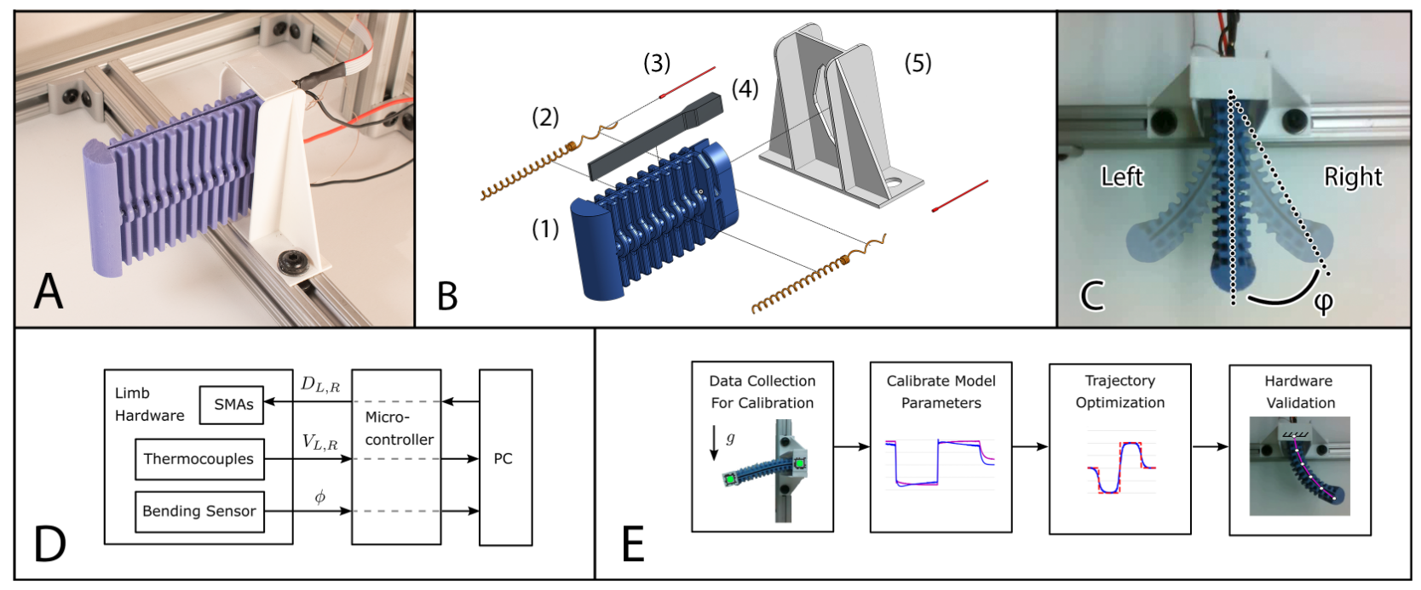
Hardware configuration
A. Cast silicone limb mounted to test fixture
B. Exploded view of limb (1), SMA actuators (2), thermocouples (3), bend sensor (4), and mounting bracket (5)
C. Top down view of actuation and bend angle
Notes:
With that, let us move on to our work, starting with the hardware configuration we have built and wanted to model.
This continuum limb you see in the first panel is cast silicone, and includes two SMA coil actuators on either side, panel B, acting antagonistically to induce bending either clockwise or counterclockwise about the fixed base, panel C.
For the purposes of calibration we’ve also embedded a capacitive bend sensor along the length of the limb, and we’ve bonded thermocouples to both SMA wires with thermally conductive epoxy.

Slide 9
Data flow and experimental design
D. Data flow diagram
E. Experimental design
Notes:
No surprises in the system data flow: our sensors and actuators are in the limb hardware, interfaced with a microcontroller which communicates with a laptop computer to configure the system, collect telemetry, and issue commands.
We’ll go over the experimental design pipeline in more detail, but briefly, we start with data collection on the hardware device which is used to identify model parameters for calibration;
We’ll move to discuss the trajectory optimization used to design feasible trajectories and open loop controls;
And then we’ll discuss performance on the hardware platform itself.

Slide 10
Dynamics Modeling
Continuum limb, Thermal actuator
Notes:
But first, let’s look at the modeling employed for the system, starting with the dynamics of the continuum limb and thermal actuators.

Slide 11
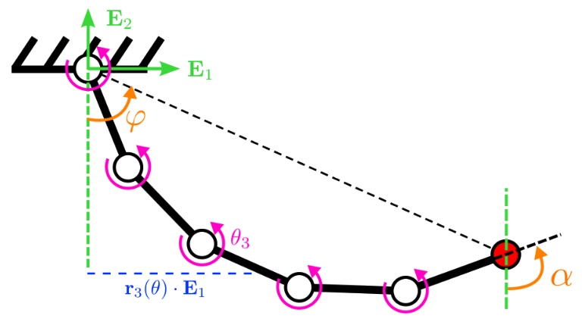
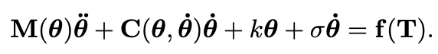
Continuum limb manipulator model
Used typical rigid link manipulator model
Alternatives exist, namely DER
Notes:
First, the limb.
We chose to use a discrete approximation of a continuum limb using a typical rigid link manipulator model.
There are alternatives, of course, in particular discrete elastic rods, but the rigid serial manipulator is a simple model well understood in the robotics community and supported in software packages, and one of our goals was to simplify the modeling while still achieving reasonable performance.
The dynamics are described below in the usual way below.

Slide 12
Continuum limb manipulator model
Used typical rigid link manipulator model
Alternatives exist, namely DER
Added:
Torsional spring at joints
Notes:
We’ve added a term corresponding to the torsional springs we place at all the revolute joints between segments, highlighted in blue.

Slide 13
Continuum limb manipulator model
Used typical rigid link manipulator model
Alternatives exist, namely DER
Added:
Torsional spring at joints
Viscous damping
Notes:
And a catch-all viscous damping to encompass energy dissipated.

Slide 14
Continuum limb manipulator model
Used typical rigid link manipulator model
Alternatives exist, namely DER
Added:
Torsional spring at joints
Viscous damping
Actuator torques (next)
Notes:
Finally, the actuator torques, which I’ll describe next.

Slide 15
Shape memory alloys (SMA)
Crystal lattice deformations translate to macroscopic strain
Wikipedia contributors. "Shape-memory alloy." Wikipedia, The Free Encyclopedia. Wikipedia, The Free Encyclopedia, 7 Apr. 2022. Web. 25 Apr. 2022.
Notes:
But first, let’s take a brief look at shape memory alloys, which are particular metal alloys which exhibit a shape memory effect which I’ll describe.
You might find this animation from Wikipedia helpful.
An interesting property of these alloys is that the microscopic behavior of lattice reconfiguration and shear strains in the crystalline structure due to applied stress or temperature change yields macroscopic stress and strain which we use for actuation.

Slide 16
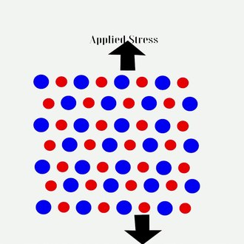
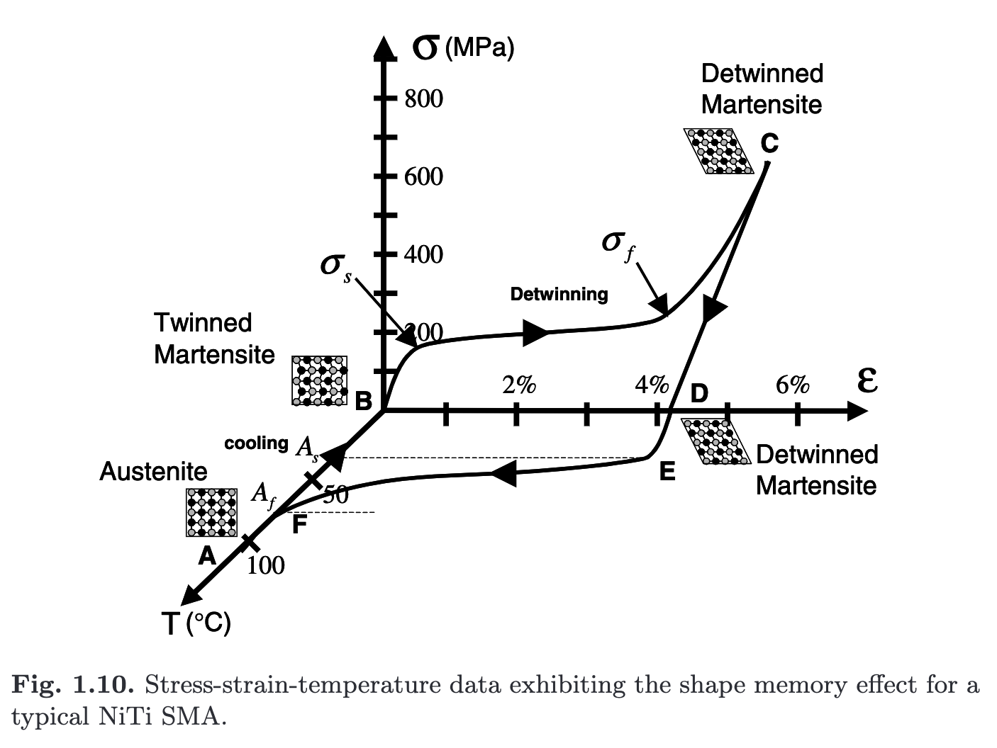
Shape memory alloys (SMA)
Crystal lattice deformations translate to macroscopic strain
Shape memory effect
Wikipedia contributors. "Shape-memory alloy." Wikipedia, The Free Encyclopedia. Wikipedia, The Free Encyclopedia, 7 Apr. 2022. Web. 25 Apr. 2022.
Single actuation path
Lagoudas, Dimitris C., ed. Shape memory alloys: modeling and engineering applications. Springer Science & Business Media, 2008.
Notes:
This behavior gives rise to a few interesting phenomena, one of which being a shape memory effect, wherein a quasi-permanent lattice configuration is remembered.
The material can then be deformed to store shear stress in the lattice configuration.
Upon heating the material, these internal stresses try to pull the material back to its original configuration.

Slide 17
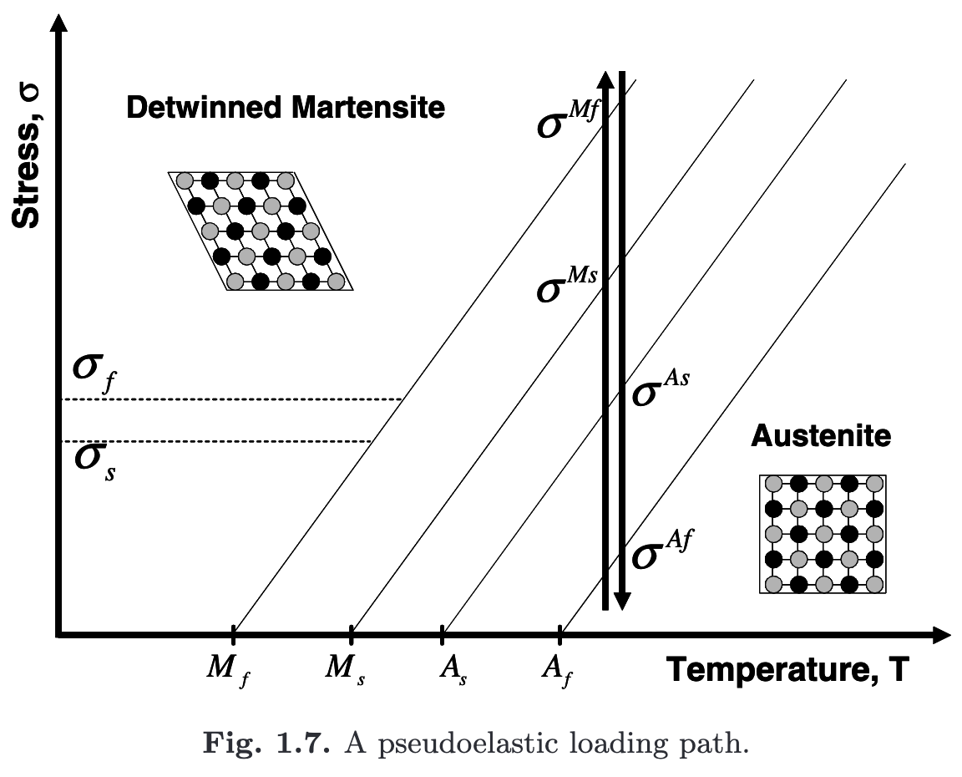
Shape memory alloys (SMA)
Crystal lattice deformations translate to macroscopic strain
Shape memory effect
Pseudoelasticity
Wikipedia contributors. "Shape-memory alloy." Wikipedia, The Free Encyclopedia. Wikipedia, The Free Encyclopedia, 7 Apr. 2022. Web. 25 Apr. 2022.
Lagoudas, Dimitris C., ed. Shape memory alloys: modeling and engineering applications. Springer Science & Business Media, 2008.
Single actuation path
Psuedoelastic loading path
Notes:
It also gives rise to a psuedoelastic effect, were, above a particular temperature, the material behaves like a metal rubber band, exhibiting a phenomenological “elasticity” similar to the elastomers we’re more familiar with, but due physically to different mechanical interactions, mentioned before.

Slide 18
Shape memory alloys (SMA)
Crystal lattice deformations translate to macroscopic strain
Shape memory effect
Pseudoelasticity
Challenges
Hysteretic effects on stress- and temperature- induced deformations
Wikipedia contributors. "Shape-memory alloy." Wikipedia, The Free Encyclopedia. Wikipedia, The Free Encyclopedia, 7 Apr. 2022. Web. 25 Apr. 2022.
Lagoudas, Dimitris C., ed. Shape memory alloys: modeling and engineering applications. Springer Science & Business Media, 2008.
Single actuation path
Psuedoelastic loading path
Notes:
This imposes some considerable challenges to the modeling of these devices.
First, there are hysteretic behaviors observed in the dynamics, outlined in red on bottom right figure.
You can see there are different sets of transition temperatures for moving from one material phases to another.

Slide 19
Shape memory alloys (SMA)
Crystal lattice deformations translate to macroscopic strain
Shape memory effect
Pseudoelasticity
Challenges
Hysteretic effects on stress- and temperature- induced deformations
Transformation temperatures change based on stress
Wikipedia contributors. "Shape-memory alloy." Wikipedia, The Free Encyclopedia. Wikipedia, The Free Encyclopedia, 7 Apr. 2022. Web. 25 Apr. 2022.
Lagoudas, Dimitris C., ed. Shape memory alloys: modeling and engineering applications. Springer Science & Business Media, 2008.
Single actuation path
Psuedoelastic loading path
Notes:
Further, those temperatures change with the applied load.
This property gives rise to the psuedoelasticity mentioned.

Slide 20
Shape memory alloys (SMA)
Crystal lattice deformations translate to macroscopic strain
Shape memory effect
Pseudoelasticity
Challenges
Hysteretic effects on stress- and temperature- induced deformations
Transformation temperatures change based on stress
Martensite fractions difficult to measure
Wikipedia contributors. "Shape-memory alloy." Wikipedia, The Free Encyclopedia. Wikipedia, The Free Encyclopedia, 7 Apr. 2022. Web. 25 Apr. 2022.
Lagoudas, Dimitris C., ed. Shape memory alloys: modeling and engineering applications. Springer Science & Business Media, 2008.
Single actuation path
Psuedoelastic loading path
Notes:
Finally, the material properties and system dynamics are dependent on the metallurgical phase, or, in aggregate, on the proportion of material in one phase or another.
This state variable, termed the “martensite fraction”, is not practical or perhaps even possible to measure in operation.

Slide 21
SMA actuation model
Notes:
Okay, so how do we move forward?
Well, we’ll keep it as simple as possible.

Slide 22
SMA actuation model
Ignore hysteresis
Notes:
We’ll start by ignoring hysteresis, which otherwise adds discontinuities to the dynamics making them more challenging to optimize over.
This has the effect of largely averaging over those transition temperatures, which is of course not ideal.

Slide 23
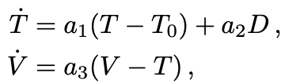
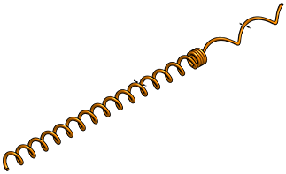
SMA actuation model
Ignore hysteresis
Convective heat transfer model: (ignoring effect of martensite fraction)
Convective cooling
Joule heating
SMA actuator coil
Convective cooling
Joule heating
Notes:
Second, to model the temperature dynamics (since, again, we’re dealing with thermal actuation), we’ll consider just the effects of convective cooling as the coils, exposed to air, passively cool, along with resistive Joule heating, achieved by running current through the wires to heat them up.
We’ll ignore the effects of material phase.

Slide 24

SMA actuation model
Ignore hysteresis
Convective heat transfer model: (ignoring effect of martensite fraction)
Convective cooling
Joule heating
Thermocouple
Thermal mass of epoxy
Epoxy
SMA actuator coil
Convective cooling
Joule heating
Notes:
But note our thermocouples are not in direct contact with the wires.
We have epoxy bonding the thermocouple to the SMA coil, which adds its own thermal mass and heat transfer characteristics which we try to account for with this second equation describing the dynamics of the thermocouple temperature measurement V.

Slide 25
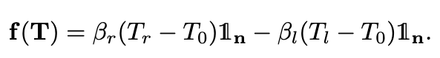
SMA actuation model
Ignore hysteresis
Convective heat transfer model: (ignoring effect of martensite fraction)
Linear force mapping:
Convective cooling
Joule heating
Thermocouple
Thermal mass of epoxy
Epoxy
SMA actuator coil
Convective cooling
Joule heating
Notes:
Finally, we’re going to keep things simple and say the force is a linear scaling of the temperature.

Slide 26
SMA actuation model
Ignore hysteresis
Convective heat transfer model: (ignoring effect of martensite fraction)
Linear force mapping:
Reasonable for some operating conditions, not all
Ignores martensite fraction
Assumes linear relationship between martensite fraction and temperature
Convective cooling
Joule heating
Thermocouple
Thermal mass of epoxy
Epoxy
SMA actuator coil
Convective cooling
Joule heating
Notes:
This is not true, although within a particular range of operation we did observe a fairly linear relationship between the temperature and effected force.
However, we’re ignoring the effect the material phase has on, for example, transition temperatures.
Despite that, we do end up achieving good performance, albeit with some caveats, all of which we’ll discuss soon

Slide 27
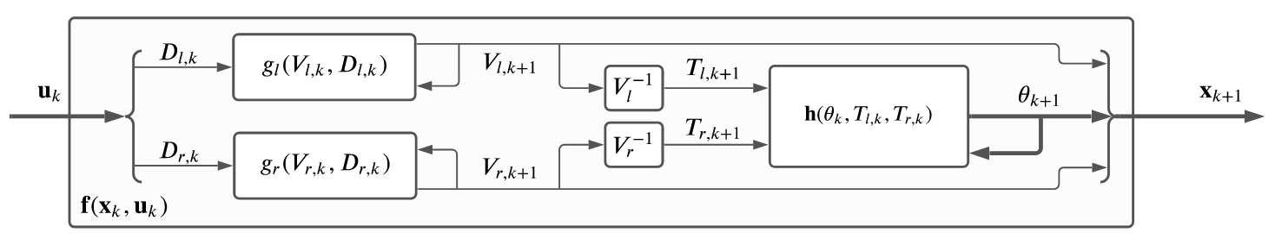
Complete dynamics block
Notes:
So here are the full system dynamics.

Slide 28
Complete dynamics block
Control inputs
Notes:
Starting from the control inputs, our PWM duty cycles…

Slide 29
Complete dynamics block
Control inputs
SMA dynamics
Notes:
…moving into the actuator dynamics to model the thermal behavior…

Slide 30
Complete dynamics block
Sensor measurements
Control inputs
SMA dynamics
Notes:
…from which we get our thermocouple measurements…

Slide 31
Complete dynamics block
Transform to SMA temperature
Sensor measurements
Control inputs
SMA dynamics
Notes:
…which we can transform into wire temperatures using our thermal model parameters…

Slide 32
Complete dynamics block
Transform to SMA temperature
Sensor measurements
Control inputs
SMA dynamics
Manipulator dynamics
Notes:
…and this feeds into the serial manipulator dynamics…

Slide 33
Complete dynamics block
Transform to SMA temperature
Sensor measurements
Control inputs
SMA dynamics
Manipulator dynamics
Next state vector
Notes:
…finally yielding the next system configuration.

Slide 34
Kinematics Modeling
Constant curvature, Euler-Bernoulli beam
Notes:
Let’s now briefly discuss the kinematics models employed, which we’ll use later in model calibration.

Slide 35
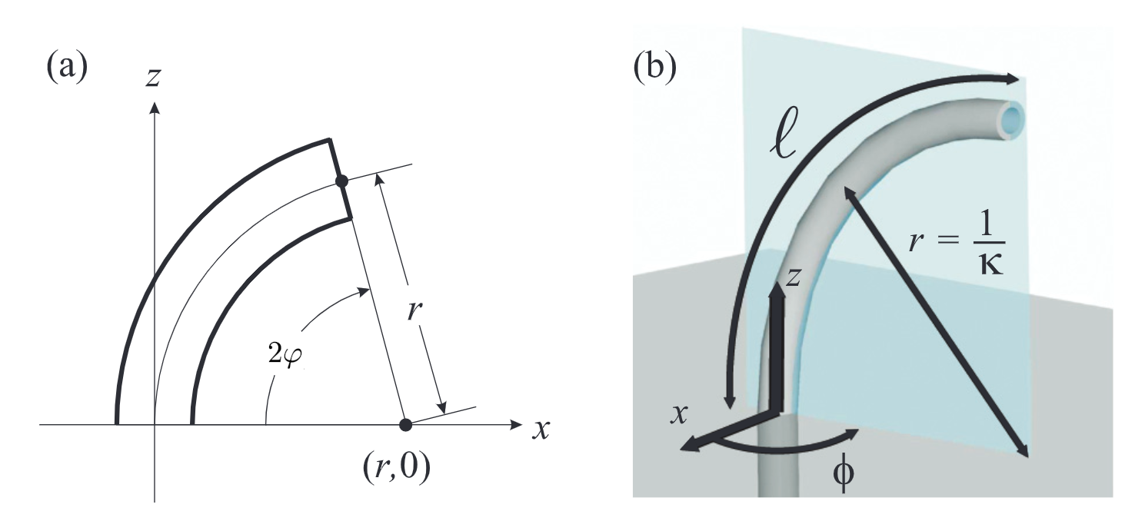
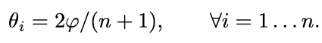
Constant curvature assumption
Assuming uniform actuator torques and
Manipulator joint angle i
Bend angle
Webster III, Robert J., and Bryan A. Jones. "Design and kinematic modeling of constant curvature continuum robots: A review." The International Journal of Robotics Research 29.13 (2010): 1661-1683.
Modified from figure 3.
Notes:
Under actuation only, we assume constant curvature of the manipulator, so it’s a perfect arc of a circle of some radius.
Under this assumption, with a little trig, we come up with a simple relationship between the bend angle measurement and the model joint angles.

Slide 36
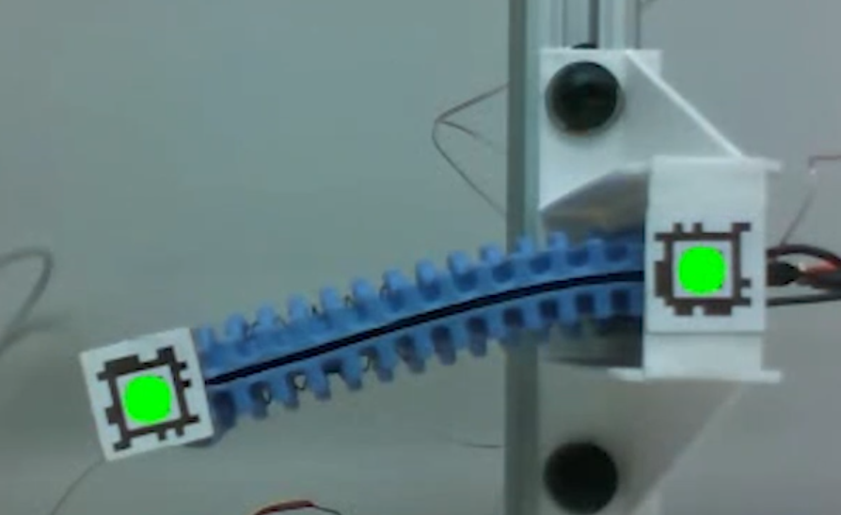
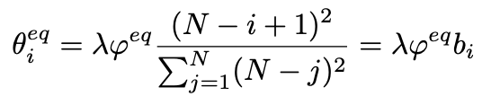
Euler-Bernoulli beam assumption under gravity
Successive joint angles decrease exponentially.
gravity
Manipulator joint angle i at equilibrium
Bend angle at equilibrium
Material-dependent scaling parameter
Notes:
Another assumption we’ll use is a discrete Euler-Bernoulli beam approximation.
In one data collection experiment we orient the bend axis perpendicular to gravity to let the limb passively bend.
Then we can use the model to arrive at the expected bending angles along the beam, with the angles falling off exponentially moving away from the fixed end.

Slide 37
Data Collection & Model Calibration
Notes:
With that, let’s discuss model calibration, and the data collection strategies used to isolate parameters.

Slide 38
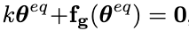
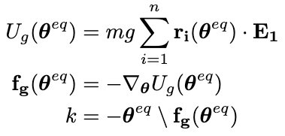
Torsional spring coefficient
Limb was rotated 90°, left to bend under gravity
Simplified dynamics:
Bend angle measured at static equilibrium
Constant curvature does not apply; use EB kinematics
gravity
Notes:
First, let’s take a look at that spring coefficient.
The limb is oriented to undergo gravitation loading.
In static equilibrium the dynamics are simply two terms: the spring forces and the gravitational loading.
We have the measured bend angle, so now using that Euler-Benoulli mapping to joint space we can compute the gravitational loading and then the spring constant k with a least-squares fit.

Slide 39
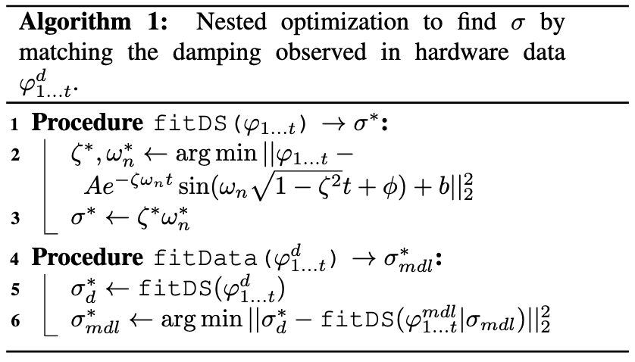
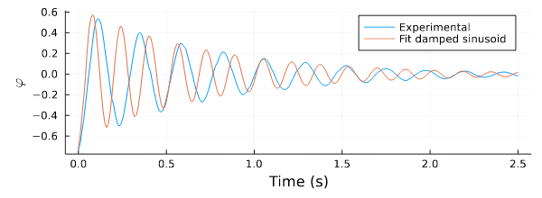
Damping coefficient
Release limb tip from bent position and collect data from damped oscillation
Dynamics:
CC does not apply.
EB difficult to apply without forces.
Instead, nested optimization:
Fit a damped sinusoid to bend angle trajectory
Find the damping coefficient which produces the closest fit
Notes:
We move on to the damping coefficient.
We release the limb from a known angle and allow it to passively oscillate, collecting data until the energy dissipates and motion stops.
There is only one unknown now in the manipulator dynamics, but here we don’t have a valid mapping to joint space, as the constant curvature assumption doesn’t hold under large dynamics and the Euler-Bernoulli beam assumption is difficult to apply without knowing the loading at each link.
Instead, we perform a nested optimization.
From the collected hardware data we have generated a trajectory from the measured bend angle, shown on the bottom right in blue.
We fit a damped sinusoid to this trajectory and wish to find the corresponding damping coefficient sigma in our manipulator model such that, when the dynamics are rolled out, the damping in the simulated bend angle trajectory matches that of the observed data.
So we can optimize for the value of sigma where, at each step, we roll out the dynamics, fit a damped sinusoid, and compare coefficients with the observed data, and decide if we’re close enough or not.
In this way we’re able to reproduce the damping, which you can see in the bottom figure without needing a mapping to joint space.
As an aside, note that the resonant frequency of the simulated system does not match that of the observed hardware.
This is due to our modeling of the manipulator as a uniform density rod, as opposed to the true system which incorporates the limb in addition to two springs on either side.
If we want to match the resonant frequency in addition to the damping, we need to better model the manipulator structure, but for this limb, this isn’t a concern.

Slide 40
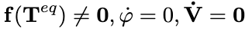
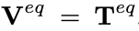
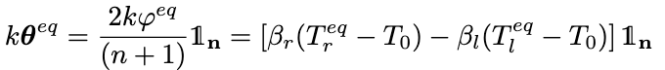
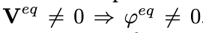
Thermal actuator calibration setup
Collect data under three conditions:
Actuated,
Static equilibrium,
Thermal equilibrium.
Then make three assumptions:
Notes:
Moving on to the actuation model.
First, we collect data under three conditions: the system is actuated (each side independently); the system is in static equilibrium, so we’re not moving; and the system is in thermal equilibrium, so we’re not heating up or cooling down.
This allows us to make three assumptions.
First, we say that the thermocouple measurement has equilibrated to the true SMA wire temperature, or at least pretty close to it.
Second, that the manipulator dynamics are governed only by the spring forces and actuator forces, we can ignore other terms.
And finally, since we have a non-zero temperature offset, we have a non-zero bend.

Slide 41
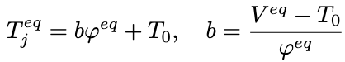
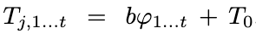
Thermal actuator heat transfer coefficients
Collect data under three conditions:
Actuated,
Static equilibrium,
Thermal equilibrium.
Then make three assumptions:
From assumptions 1 & 2,
Use relationship to roughly scale the rest of the time series:
With T, V, and D known, fit system of ODEs using Julia DiffEqParamEstim.jl package
Notes:
With this we can identify parameters in the system of ODEs describing the thermal dynamics, a1, a2, and a3, first by combining the first and second assumptions to derive a relationship between the equilibrium temperature and the measurement temperature.
Given our model definition, this relationship should hold everywhere, so we can use it to compute wire temperatures all along a trajectory, even where these equilibrium conditions are not met.
Now we have measurements for the wire temperature T, measurement temperature V, and duty cycle D, and we can use off-the-shelf fitting packages to identify the parameters that yield the observed dynamics.

Slide 42
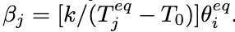
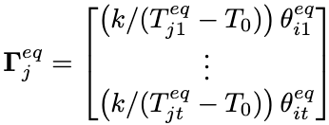
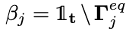
Thermal actuator force coefficients
Collect data under three conditions:
Actuated,
Static equilibrium,
Thermal equilibrium.
Then make three assumptions:
From assumption 2, observe
Take all such points, stack in vector:
Then compute directly:
Notes:
Then, to determine the actuation force coefficients, we can simply use these equilibrium points, and the relationship from assumption 2, to identify the parameter beta.
We can stack all such observations in a big matrix then look for a least squares fit.

Slide 43
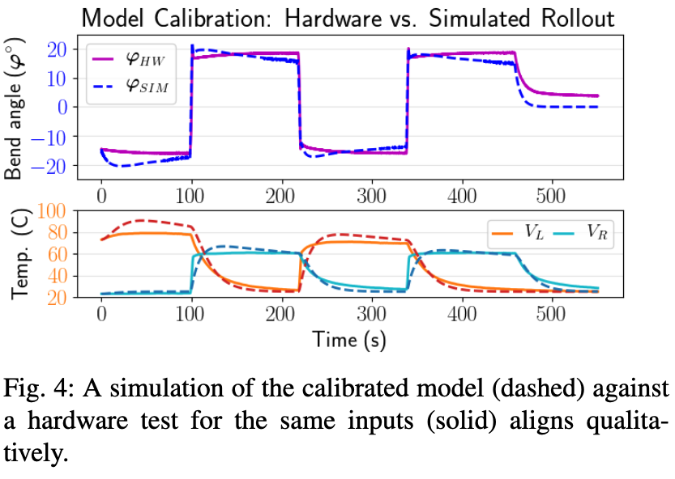
Good model calibration agreement
Notes:
This figure shows bend angle and temperature trajectories for the hardware calibration dataset, the solid lines, and the simulated dataset, showed in dashed lines.
The simulated data was derived by using the initial conditions from the hardware data, that is, the first observation, then rolling out the dynamics using the identified model parameters.
We see reasonable agreement between the two.

Slide 44
Trajectory optimization
Notes:
So let’s move on to using these calibrated models to design system behavior and controls.

Slide 45
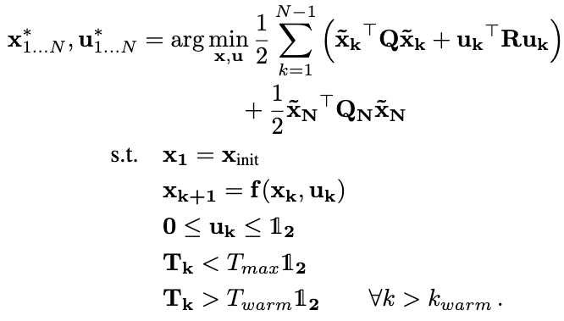
Optimization setup
Optimized feasible state trajectory
Optimized open-loop control trajectory
Tracking error
Quadratic-cost optimization
Q (tracking error penalties) only cares about positions
R (control penalties) included to minimize control signals
Constraints:
Initial condition
System dynamics
Valid controls
Safe temperatures
Warm operation
Notes:
We optimized for the feasible trajectory and the open loop controls to achieve it by direct collocation in a non-linear program setup.
For a given reference trajectory, which is hidden behind those tildes which indicate the tracking error, we perform the optimization using a typical quadratic cost objective function.
Our weighting Q of the tracking error x tilde only cares about matching the joint positions, we don’t care about the temperatures or rates.
And the weighting R is included to minimize the commanded control signals, and as a soft complementarity constraint, since ideally we would only be actuating one SMA at a time.
We include a number of constraints:
First, the known initial condition;
Second, we want the trajectory to obey the system dynamics;
Third, the control signals, which are the PWMs, have a limited range;
Fourth, we have safety constraints incorporated as a maximum wire temperature to avoid permanently deforming or damaging the actuators;
And finally, we try to keep the coils “warm” after a certain period of time.
I’ll explain this later.

Slide 46
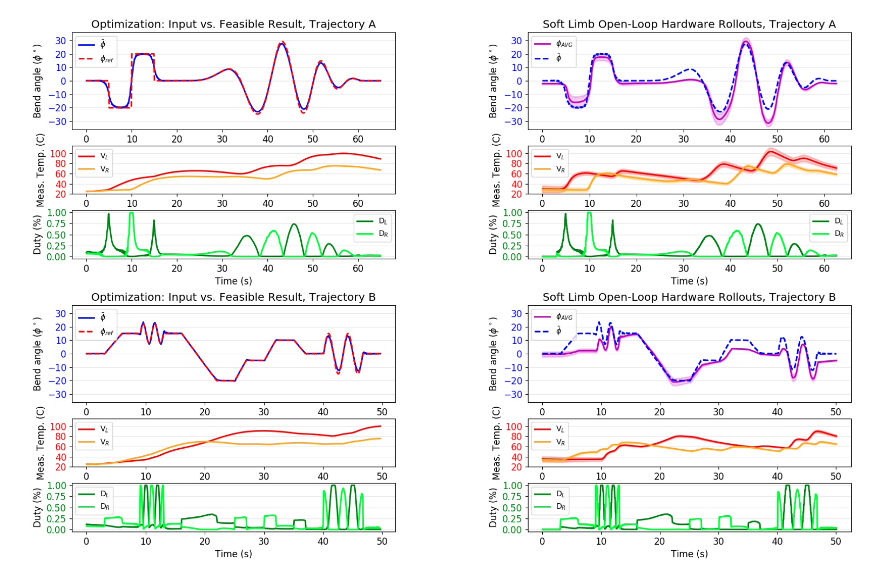
Optimization results
Notes:
With this setup we’re able to provide a desired reference trajectory and, through optimization, find a close feasible trajectory based on the model dynamics, along with the control signals to realize that trajectory.
You can see from the top plots the rolled out trajectories align very well to the references, in simulation at least.

Slide 47
Open-loop Tracking Results
Notes:
So let’s see how well this translated to the actual hardware.

Slide 48
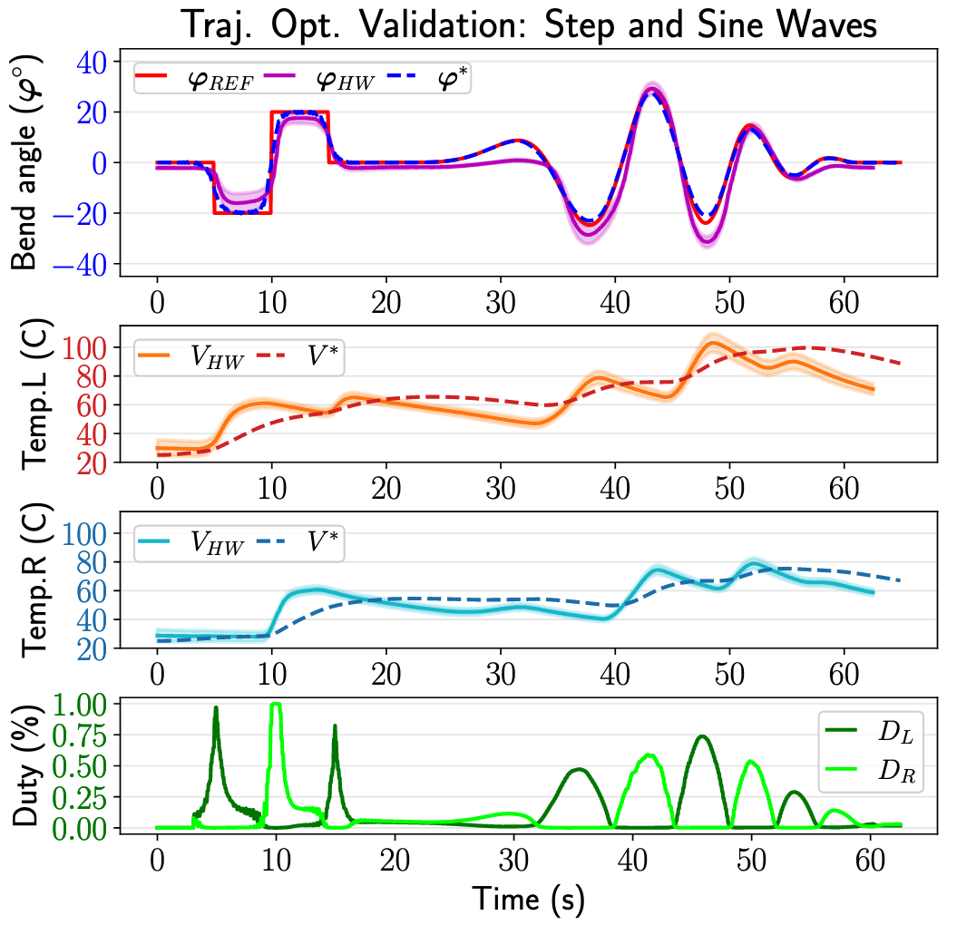
Hardware validation
Hardware tracking good, but improvement is needed
“Soft” startups difficult
Some tracking bias observed
Temperature does not track
Timescale of original validation too long
Thermal model fit motion dynamics well (“T”) but not observations (“V”)
Notes:
So overall, we see the open-loop position tracking in hardware, that top plot, is reasonable, typically within a few degrees of the reference, but there’s definitely room for improvement.

Slide 49
Hardware validation
“Soft” startup
Hardware tracking good, but improvement is needed
“Soft” startups difficult
Some tracking bias observed
Temperature does not track
Timescale of original validation too long
Thermal model fit motion dynamics well (“T”) but not observations (“V”)
Notes:
One issue we observe is this “soft startup”, indicated by the red arrow, where we have a low starting temperature and we want to perform a small action.
This is likely an artifact of not taking into account the hysteretic behavior of the actuators, so the model thinks it can get away with applying a low control input to move the limb ever so slightly, when in reality there is a sort of “activation energy” we need to overcome to get things moving in the first place.
This is what we tried to compensate for with this warm-up temperature mentioned in the trajectory optimization, and we did see some very minor improvements, but overall this can not solve the problem without making the system excessively stiff.

Slide 50
Hardware validation
“Soft” startup
Tracking bias
Hardware tracking good, but improvement is needed
“Soft” startups difficult
Some tracking bias observed
Temperature does not track
Timescale of original validation too long
Thermal model fit motion dynamics well (“T”) but not observations (“V”)
Notes:
We also see tracking bias on the extremum, both for small actuations as previously described and also for large ones, indicated in pink.
In addition to the ignored hysteresis, we hypothesize that the linear mapping from temperature to actuation force is probably much too coarse of a simplification to achieve precise motion.

Slide 51
Hardware validation
“Soft” startup
Tracking bias
Hardware tracking good, but improvement is needed
“Soft” startups difficult
Some tracking bias observed
Temperature does not track well
Timescale of original validation too long
Thermal model fit motion dynamics well (“T”) but not observations (“V”)
Notes:
More strikingly, the measurement temperature tracking, what we would expect to see from the thermocouple, follows the general trend but is not sufficiently dynamic.
There is considerable lag and damping in the tracking which would make it completely unusable either for understanding the true physical behavior of the system or for use in feedback control.
However, combined with the other model parameters, both the conversion to a wire temperature and the resulting force mapping, we do still observe a responsive actuation, despite the suboptimal tracking performance.
Why does this happen?

Slide 52
Hardware validation
“Soft” startup
Tracking bias
Hardware tracking good, but improvement is needed
“Soft” startups difficult
Some tracking bias observed
Temperature does not track well
Timescale of original validation too long
Thermal model fit motion dynamics well (“T”) but not observations (“V”)
Notes:
Well, if we take a look at the original validation dataset used to identify model parameters, what I said looked “good” was actually zoomed out at a much larger time-scale than that which we want to operate on.
Looking more closely you can see the considerable lag that existed even in this fit.
But since the majority of the data have relatively “slow” dynamics, the fit parameters were happy with a non-physical set that largely reproduced the measurement data.
This was not detrimental to open-loop control, but of course it would be for closed loop, as mentioned, and it’s not clear how well safety constraint violations could be mitigated if we’re not faithfully reproducing the physical behavior as closely as possible.

Slide 53
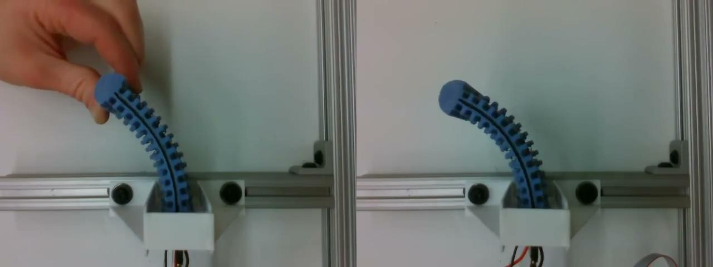
Teach
-and-
Repeat
Notes:
But moving on from that, we performed some teach and repeat experiments, as seen in this video, where the limb was manually manipulated to generate a “desired” trajectory.
This trajectory was fed through the pipeline to arrive at a close feasible trajectory, based on the model parameters, along with the controls necessary to achieve the motion.
The outcome is on the right, where the limb was trained to reproduce the desired trajectory.
Qualitatively, this works well.

Slide 54
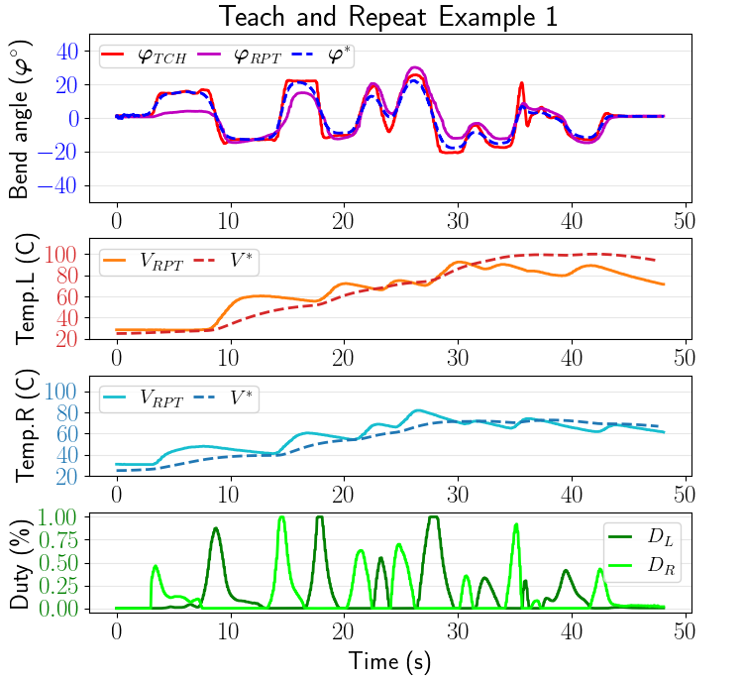
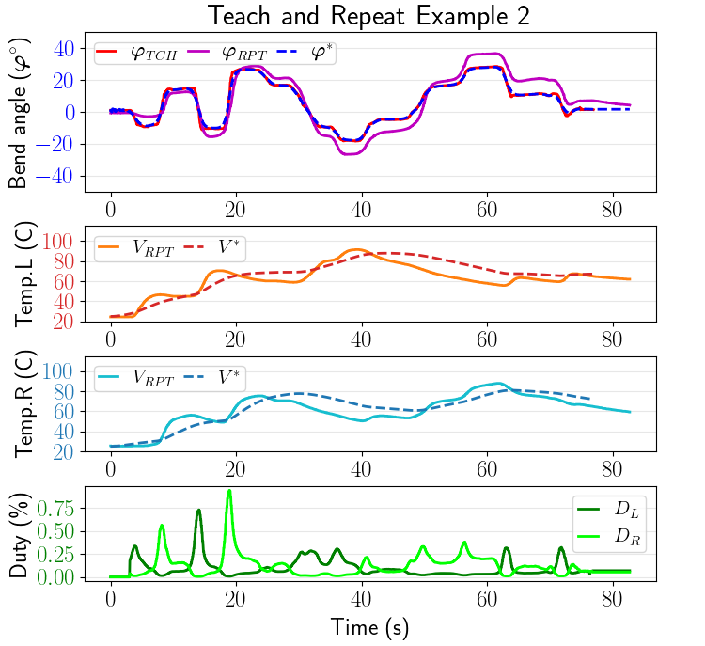
Teach-and-repeat results
Notes:
And quantitatively as well, maintaining the same caveats as before: we see median tracking error around 2-5 degrees.
I’ll note the bend sensor accuracy is only around 2 degrees.
We do still see the same issues with soft startups and hitting large angles precisely, giving us larger tracking errors as much as 10-15 degrees in those regions.
And, of course, temperature tracking is again hitting the trend but not as dynamic as we would like.

Slide 55
Future Work
Improvements to SMA force model
At least rudimentary modeling of hysteresis
Better stress mapping, especially outside linear region
Improvements to SMA temperature model
Higher priority on matching measurement temperature
Extend to multi-link system
Full Horton robot is composed of five links (three legs, two shoulders)
Notes:
So where do we go from here?

Slide 56
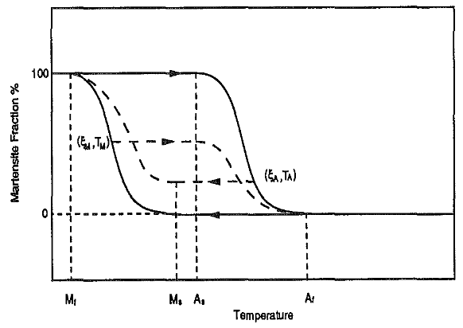
Future Work
Shape memory alloy hysteresis [1]
Improvements to SMA force model
At least rudimentary modeling of hysteresis
Better stress mapping, especially outside linear region
Improvements to SMA temperature model
Higher priority on matching measurement temperature
Extend to multi-link system
Full Horton robot is composed of five links (three legs, two shoulders)
[1] Liang, Chen, and Craig A. Rogers. "One-dimensional thermomechanical constitutive relations for shape memory materials." Journal of intelligent material systems and structures 8.4 (1997): 285-302.
Notes:
We believe most likely we can get considerable gains by doing a better job with the SMA actuation modeling.
While position tracking performance was acceptable, a rudimentary modeling of the hysteretic behavior of the system I believe would go a long way in improving responsiveness and tracking accuracy.
In particular it should help alleviate that soft start problem.

Slide 57
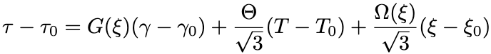
Future Work
Shape memory alloy hysteresis [1]
Improvements to SMA force model
At least rudimentary modeling of hysteresis
Better stress mapping, especially outside linear region
Improvements to SMA temperature model
Higher priority on matching measurement temperature
Extend to multi-link system
Full Horton robot is composed of five links (three legs, two shoulders)
SMA unified constitutive relation [2]
[1] Liang, Chen, and Craig A. Rogers. "One-dimensional thermomechanical constitutive relations for shape memory materials." Journal of intelligent material systems and structures 8.4 (1997): 285-302.
[2] Cheng, Shing Shin, Yeongjin Kim, and Jaydev P. Desai. "Modeling and characterization of shape memory alloy springs with water cooling strategy in a neurosurgical robot." Journal of intelligent material systems and structures 28.16 (2017): 2167-2183.
Notes:
In addition, trying to make more reasonable assumptions about the mapping from actuator state to applied force would improve performance.
At the very least, an accurate SMA model should be incorporated into the simulation, so even if we are fitting parameters to a less robust model, we would at least have a better idea how that model would degrade performance in hardware, and we can better tune the calibration.

Slide 58
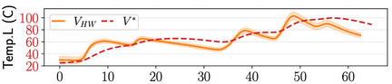
Future Work
Improvements to SMA force model
At least rudimentary modeling of hysteresis
Better stress mapping, especially outside linear region
Improvements to SMA temperature model
Higher priority on matching measurement temperature
Extend to multi-link system
Full Horton robot is composed of five links (three legs, two shoulders)
Notes:
Closed loop control and reliable safety constraints are also both objectives, and we would like to track what, physically, is really happening in the system, so better fitting the thermal model may be achieved using more dynamic data than our largely static calibration set.

Slide 59
Future Work
Improvements to SMA force model
At least rudimentary modeling of hysteresis
Better stress mapping, especially outside linear region
Improvements to SMA temperature model
Higher priority on matching measurement temperature
Investigate use of ML models to model residual error
Extend to multi-link system
Full Horton robot is composed of five links (three legs, two shoulders)
Notes:
We can even try to bridge some of these model gaps by incorporating machine learning models trained to identify residual error.

Slide 60
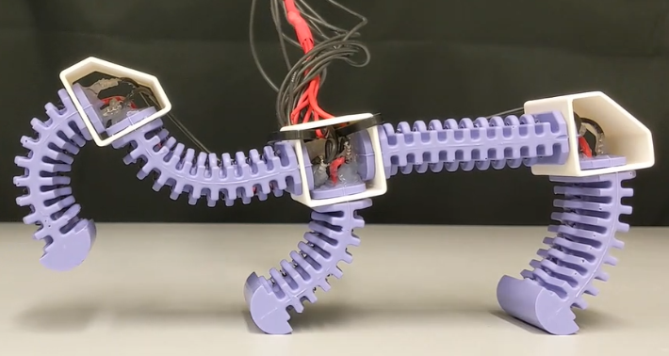
Future Work
Improvements to SMA force model
At least rudimentary modeling of hysteresis
Better stress mapping, especially outside linear region
Improvements to SMA temperature model
Higher priority on matching measurement temperature
Investigate use of ML models to model residual error and bias
Extend to multi-link system
Full Horton robot is composed of five links (three legs, two shoulders)
Notes:
And finally, we want to apply this process to a full, multi-link robot, to design gaits and more complicated behaviors.

Slide 61
Final remarks
Main contributions
Development and calibration of simplified models for thermal-actuation and soft manipulator dynamics. |  | Validation in hardware using an SMA-actuated soft manipulator.
Notes:
In summary, here are some final remarks highlighting some of the contributions I wanted to communicate to you today.

Slide 62
Final remarks
Main contributions
Development and calibration of simplified models for thermal-actuation and soft manipulator dynamics. |  | Validation in hardware using an SMA-actuated soft manipulator.
Notes:
First, we specified a few simplified models of this complicated system and demonstrated ways to collect and use data to calibrate the model parameters.

Slide 63
Final remarks
Main contributions
Development and calibration of simplified models for thermal-actuation and soft manipulator dynamics. | Design of feasible trajectories and open-loop controls through optimization. | Validation in hardware using an SMA-actuated soft manipulator.
Notes:
Second, we demonstrated the use of optimization to design feasible trajectories which closely aligned to a desired reference, along with the open-loop controls needed to achieve them.

Slide 64
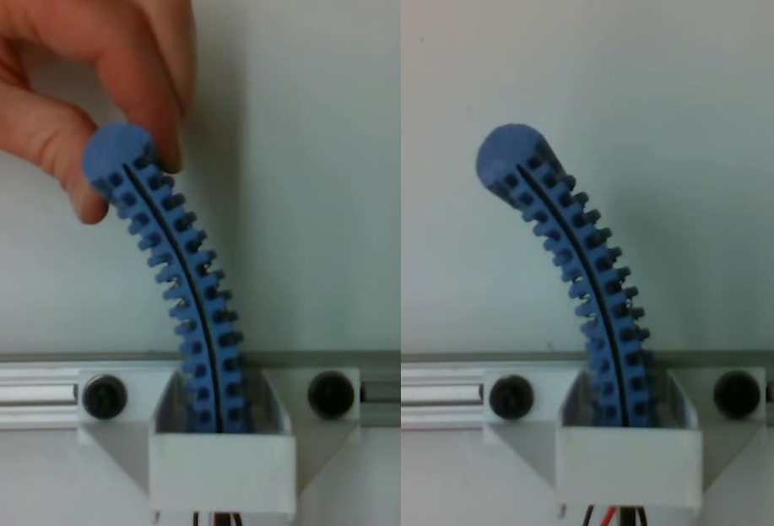
Final remarks
Main contributions
Development and calibration of simplified models for thermal-actuation and soft manipulator dynamics. | Design of feasible trajectories and open-loop controls through optimization. | Validation in hardware using an SMA-actuated soft manipulator.
Notes:
And finally, we validated the approach, simplified models and all, in hardware, achieving reasonable performance in the process.
With that, I conclude my presentation and I am happy to hear comments, questions, suggestions, criticisms, rants, etc.

